Slide 1

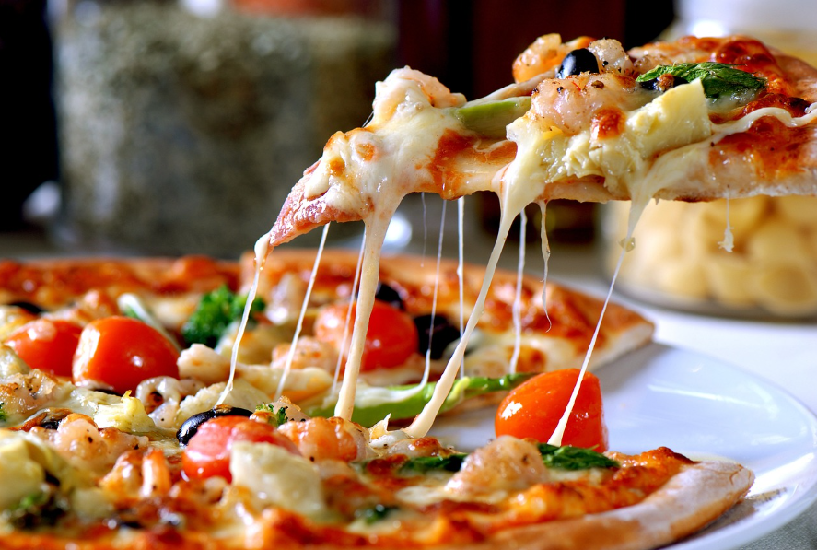
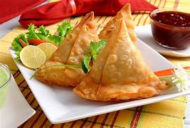


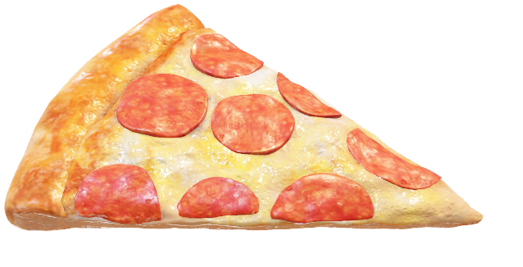

Zomato Food Sales Analysis Using SQL
Developed by,
A K S H A Y K U M A R
Notes:
NOTE: To replace a picture, just select and delete it. Then use the Insert Picture icon to replace it with one of your own!

Slide 2
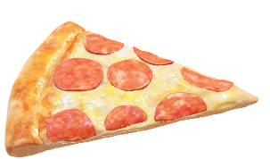
About Project
This project is a SQL-based data analysis project built on a Zomato-like food delivery database. The objective of this project is to analyze customers, restaurants, orders, menu items, reviews, and deliveries to extract meaningful business insights.
The project uses MySQL queries including joins, aggregations, subqueries, and filtering techniques to solve real-world business questions such as customer spending behavior, restaurant performance, popular food items, and delivery ratings.
This project helps in understanding how SQL is used in real-time food delivery platforms for data-driven decision making.

Slide 3

Key Focus Areas
Customer behavior analysis
Restaurant performance evaluation
Order and revenue analysis
Menu item pricing analysis
Customer reviews and ratings
Delivery performance and ratings
SQL joins, aggregations, and subqueries

Slide 4
Questions
Basic Level Questions:
List all restaurants along with their city and cuisine type.
Show all customers who belong to Gurgaon.
Display all menu items costing more than ₹200.
Show all orders that have been successfully delivered.
List all deliveries that received a 5-star rating.
Intermediate Level Questions:
Show all customers along with their orders, including customers who have not placed any order.
Display order details with customer name and restaurant name.
Find the total number of orders placed for each restaurant.
Find the average rating of each restaurant.
Show the top 3 restaurants based on the number of reviews.
Advanced Level Questions:
Find the customer who has spent the highest total amount on orders.
List the restaurants that have received more reviews than the average number of reviews per restaurant.
Find the most expensive menu item(s) in each restaurant.

Slide 5
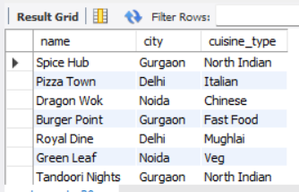
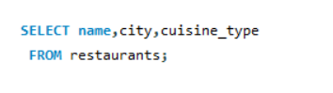
Basic : 01
Q. List all restaurants along with their city and cuisine type.
Answer:

Slide 6
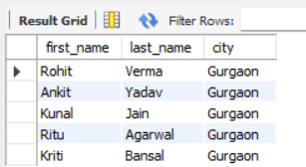
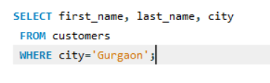
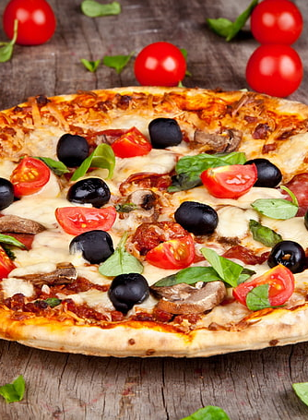
Q. Show all customers who belong to Gurgaon.
Basic : 02
Answer:

Slide 7
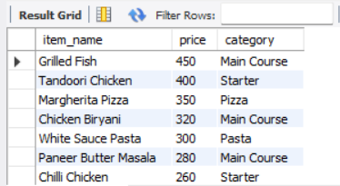
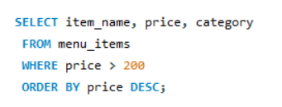
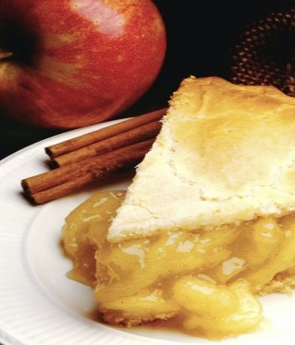
Q. Display all menu items costing more than ₹200.
Basic : 03
Answer:

Slide 8
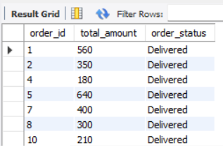
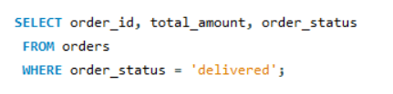
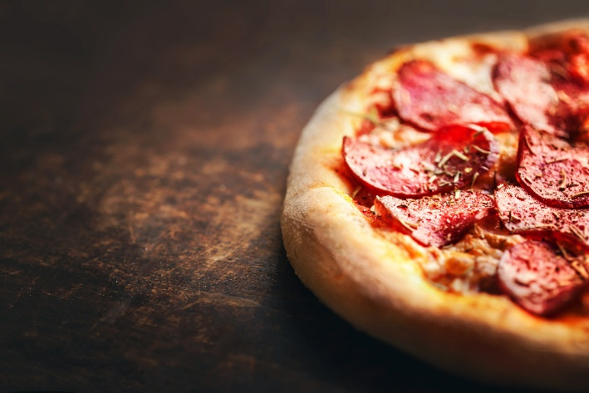
Q. Show all orders that have been successfully delivered.
Basic : 04
Answer:

Slide 9
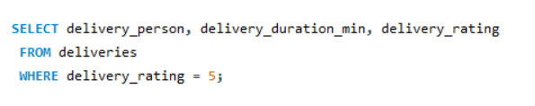
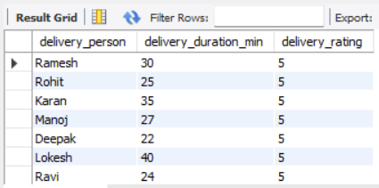
Q. List all deliveries that received a 5-star rating.
Basic : 05
Answer:

Slide 10





Zomato Food Sale Analysis Using SQL

Slide 11
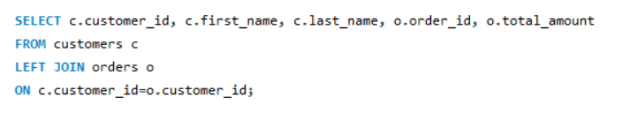
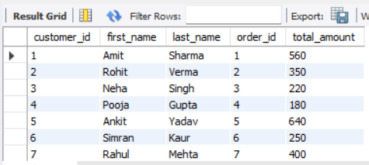
Answer:
Intermediat : 01
Q. Show all customers along with their orders, including customers who have not placed any order.

Slide 12
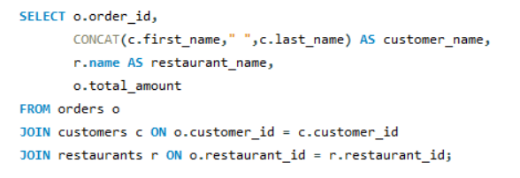
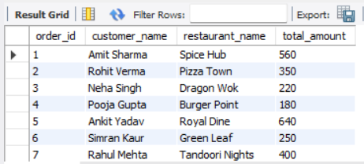
Q. Display order details with customer name and restaurant name.
Intermediate : 02
Answer:

Slide 13
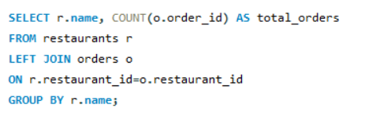
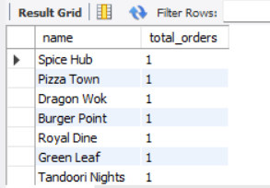
Q. Find the total number of orders placed for each restaurant.
INTERMEDIATE : 03
Answer:

Slide 14
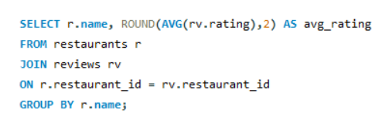
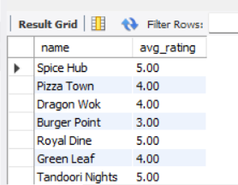
Intermediate : 04
Q. Find the average rating of each restaurant.
Answer:

Slide 15
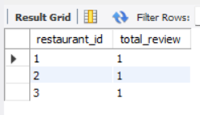
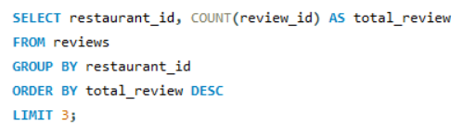
Blank slide
Intermediate : 05
Q. Show the top 3 restaurants based on the number of reviews.
Answer:

Slide 16
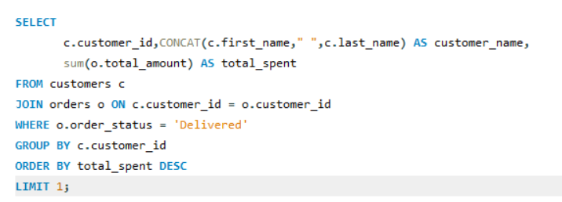
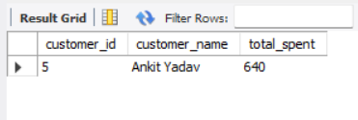
Advanced : 01
Q. Find the customer who has spent the highest total amount on orders.
Answer:

Slide 17

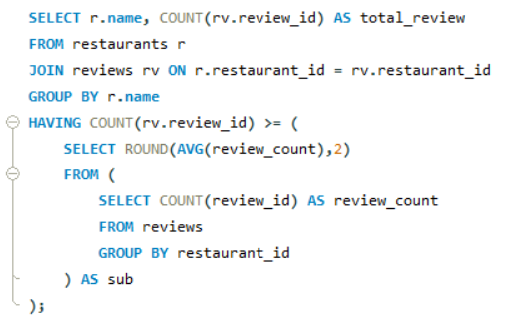
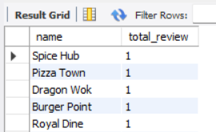
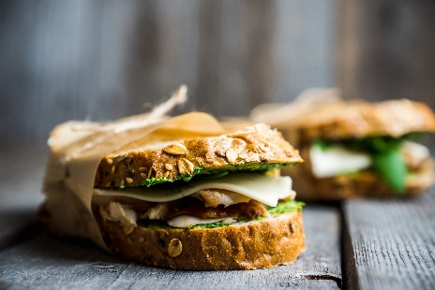
Advanced : 02
Q. List the restaurants that have received more reviews than the average number of reviews per restaurant.
Answer:

Slide 18
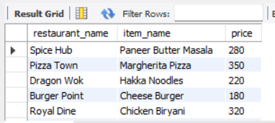
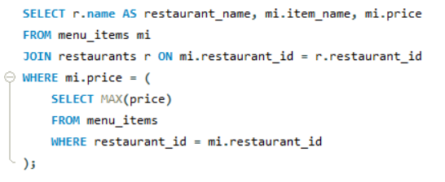
Advanced : 03
Q. Find the most expensive menu item(s) in each restaurant.
Answer:

Slide 19
Thank you For Attention
A k S H A y K U M A R
M o b: 7017813752
E m a i l: akshaykumar701781@gmail.com

